Slide 1
Welcome
MEDICARE COVERAGE
Medigap Supplement
Medicare Advantage – Part C
Medicare vs Employer Plans
Scott Standley, Trudy Dane, Toni Price
Hub International

Slide 2
Medigap Supplement
Original Medicare is good coverage, but it was never designed to cover everything.
Often, people with original Medicare Part A and B want additional coverage for things that are not covered by Medicare, such as deductibles and coinsurance.
Medigap Supplement and Medicare Advantage Part C plans were intended for just that purpose – to supplement Medicare coverages, providing you with a more complete health care package.

Slide 3
Medigap Supplement plan that’s right for you
First determine what you need.
Chronic conditions that require frequent doctor visits, Medigap Supplemental Plan F could be a good choice.
Rarely needed care, Medigap Supplemental Plan A or K (lower premium plans).
Travel outside the United States – Med Advantage Plan C or a Medigap Supplemental Plan F.
As you think about what plan to choose, take a look at your past medical bills to see what kinds of costs you might have in the future.

Slide 4
Megigap Supplement Plans
First, the claim is applied to Medicare and if Medicare pays, then these policies will pay according to their coverages. If Medicare does NOT pay the claim, then the Medigap - Supplement plans do NOT pay either.
Medigap Supplemental plans do NOT have prescription drug coverage. You will need to purchase a Part D RX policy.
The following plan examples are Medicare - Supplemental to Original Medicare:
(Medigap Supplement plans premiums are age rated, they
change every year.)

Slide 5
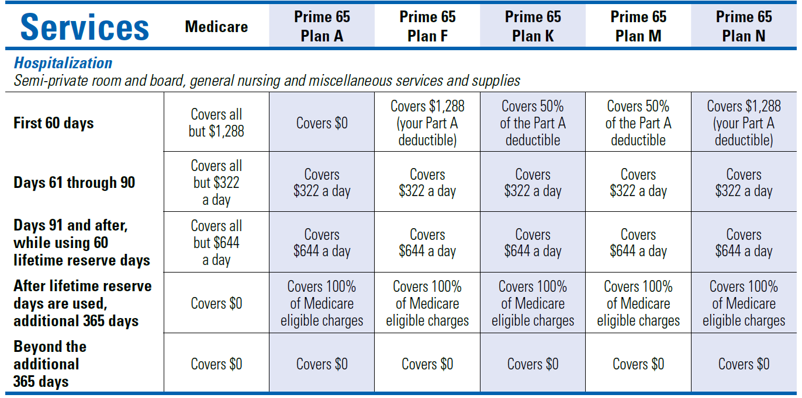
Medicare (Part A) Hospital Service-per Benefit Period
A benefit period begins on the first day you receive service as an inpatient in a hospital facility and ends after you are out of the hospital and don’t receive skilled nursing care in any other facility for 60 days in a row. The following chart outlines coverage limits for Blue Cross of Idaho Prime 65 A,F,K,M and N.

Slide 6
Medicare Advantage Plans Part C
Medicare Advantage Part C plans are an HMO (Health Management Organization) plan.
You will need to declare a Primary Care Physician (PCP).
Some services require pre-authorization and can be denied.
Some plans require referrals to see any other physician even for in network providers.
Medicare Advantage Part C plans have a network of doctors and facilities for which you will obtain your services.

Slide 7
Medicare Advantage Plans Part C
Medicare Advantage Part C plans have copays for services, maximum out of pocket limits and can have deductibles.
Most Medicare Advantage Part C plans have prescription drug coverage. If they do not, you can not buy a Part D plan. You will need to have VA or other prescription coverage.
Medicare Advantage Part C Some have extra benefits not included in original Medicare – Gym Memberships, Vision and Dental options.
Emergency and urgent care is covered as if in network regardless of where you obtain care.

Slide 8
Medicare Advantage Plans Part C
Open Enrollment is October 15th thru December 7th for a
January 1 effective date. This is the only time you can change
your Medicare Advantage Plan Part C. Can not be denied coverage.
If you do not like your Medicare Advantage Plan Part C during the year, you can dis-enroll from January 1st thru February 14th, buy a Medicare Supplement and a Part D RX card. After February 14th you can buy a Medicare Supplement, the insurance company can underwrite you and only offer certain plans or deny you coverage. You can NOT purchase a Part D Rx Drug policy after February 14th.
Medicare Advantage Part C plans are available only in specific counties. Examples are on the next slide.

Slide 9
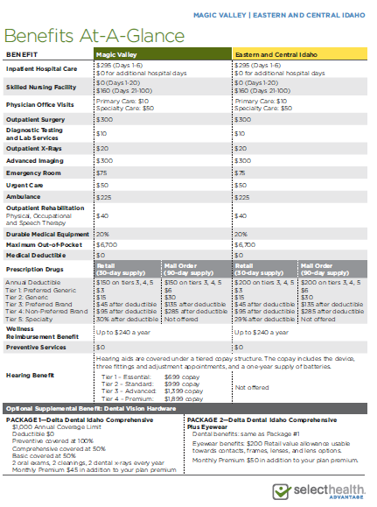
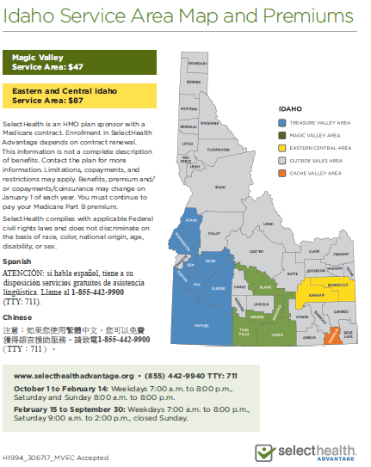
SelectHealth’s 2017 Benefits – Service Area

Slide 10
Cost Comparison
Medigap Supplement plan premiums cost between $190 to $230 per month for a 65 year old depending on the company you purchase from. If you do not have other RX Drug coverage with a Medigap Supplement, you will need a Part D RX policy and premiums range from $25 to $150 per month.
Medicare Advantage plan premiums will cost between $0 to $150 per month depending on your county and can include the Part D RX coverage.
 | Average Premium for a 65 yr. Old
Type | Part A | Part B | Medigap Med Adv | Part D Rx Drugs | Monthly Total
Medigap - Supplement | Free | $134 | $205 | $30 | $369
Med Adv | Free | $134 | $74 | Included | $208

Slide 11
Medicare vs Employer Plans
If an employer has a group plan in place and you turn 65, you can stay on the group plan. It is your option.
It is important to know if your employer plan has creditable prescription coverage. You should receive a creditable or non-creditable prescription letter from your employer.
If your employer plan has non-creditable prescription coverage, you will need to purchase a Part D RX plan.

Slide 12
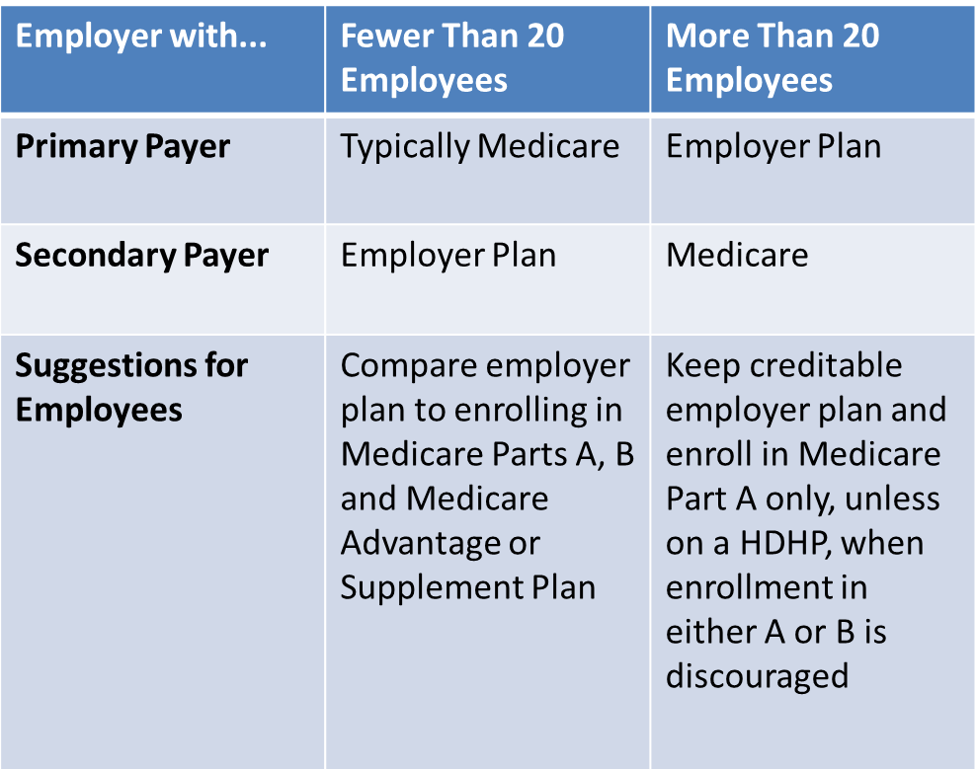
Medicare vs Employer Plan

Slide 13
For More Information
Visit Hub International’s table located in the CSI Eagles Nest.
Individual or Medicare Plans Contact:
Scott Standley- 208-737-6875
scott.standley@hubinternational.com
Group Plan Contacts:
Trudy Dane- 208-737-6418
trudy.dane@hubinternational.com
Toni Price- 208-737-6438
toni.price@hubinternational.com

Slide 14
Dennis Brown, CPA Twin Falls, Idaho
Tax Issues with Social Security Benefits

Slide 15
Computing the tax is a 18 step process This formula does not include an inflationary factor adjusted base amount of income. 1984 single amt : $25,000 (in today’s income: $92,500) 1984 married filing jointly: $32,000 (today - $118,400) Originally only the wealthy were impacted by this tax. Now almost everyone is paying this tax. The state of Idaho does not tax these benefits.
The formula was set in 1984 when Congress first put into law the ability of the federal government to tax Social Security Benefits

Slide 16
Your Benefits Can Be Taxable
About 40 percent of people who get Social Security pay income taxes on their benefits.
At the end of each year, you’ll receive a Social Security Benefit Statement (Form SSA-1099). Use this statement to complete your Federal income tax return to find out if you have to pay taxes on your benefit.
To get a replacement SSA-1099, go to my Social Security at www.socialsecurity.gov/myaccount.

Slide 17
What are some of the questions I should ask my accountant if I am still having income when I become SS eligible? Any advise to ensure I am well informed as I approach SS eligible age?

Slide 18
Time for our 2nd Break Back in the room by 11:50 am
Head over to the Eagle’s Nest
For networking with the faculty
& yummies

